Slide 1
Movoto Real Estate - Analytics
BAN 612 – Data Analytics
Prof: Jia Guo By : Karthik Kodakandla(cu2592)

Slide 2
Data Analytics for Real Estate
San Francisco( Bay Area) is always on high demand for Real Estate. The Demand for Existing homes and new homes are going high day by day.
Though with the current pandemic, Real estate industry managed to keep high compared with the previous years. According to Mercury news report Bay Area had the highest sales growth in California of nearly 40 percent over last year in December 2020.
Movoto Real Estate:
Movoto is the fifth-largest residential real estate search site and brokerage licensed in all 50 states.
The platform provides its consumers with real estate search, property listing information, market insights, neighborhood insights, and nearby points of interest.
We will use Movoto data to do some analytics on real estate.

Slide 3
Problem Statement
The main aim of this project is to collect data by web scraping and analyze the information on more than 100 properties available in San Francisco real estate market
Web Scraping and Data Collection
Extracted search results of San Francisco from Movoto website using python web scraping.
Used Beautiful Soup package in python for web scraping
Used random hits to the website with time delay to avoid bot recognition by the site
Extracted json data from each listing which includes, price, address, agent etc., and added to dictionary which is then appended to a pandas datafarame.
Extracted 1990 records and 61 columns with wide variety of columns which are treated in data cleaning

Slide 4
Data Cleaning and Outlier Detection
Deleted rows with null values using isna( ).sum( ) and dropna( )
Deleted unnecessary columns which are not useful for the further analysis
Converting the format based on the column data. For example, numerical columns are converted to int64 , data columns are converted to date format.
Duplicate values are dropped from the dataset
Outlier Detection:
Outliers are identified by calculating zscore > 3 for the numerical columns.
112 records are identified as outliers.
These outliers are dropped from the dataset
The final dataset contains 1417 rows and 23 columns which is saved to csv file.

Slide 5
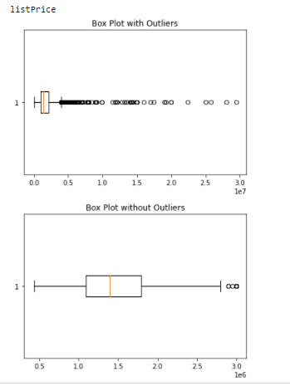
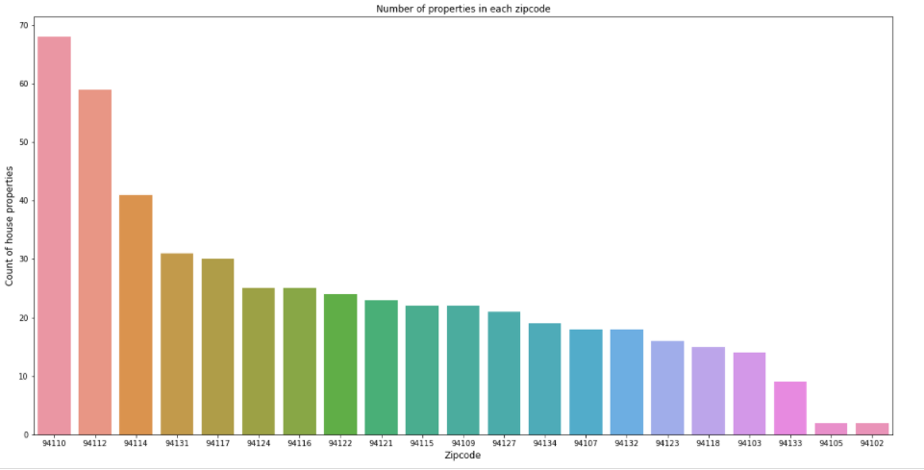
Visualization

Slide 6
Research Questions
1. Which zip code has highest and lowest Avg Price per Square feet?
2. Top 5 Listing Agents who has highest sum of list price and Top 5 listing agents with lowest sum of listing price?
3. Average price per Square feet for the property type?
4. Which has highest correlation with the predictor. (Or) which has highest important feature

Slide 7
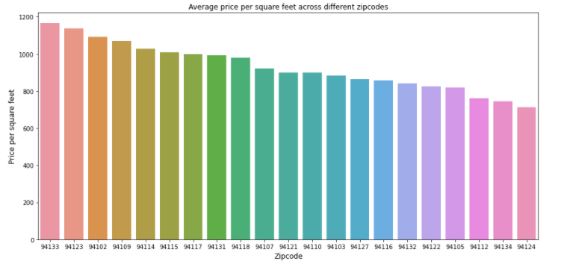
Which zip code has highest and lowest Avg Price per Square feet?
Zip code 94133 is costliest with Average price per square feet at 1165$ and Zip code 94124
is cheapest with Average price per square feet at 714$. This will help new buyers in
California region to chose the area/zipcode based on their budget

Slide 8
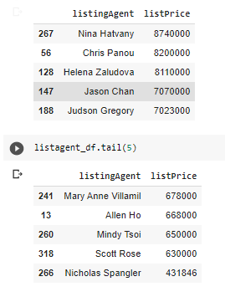
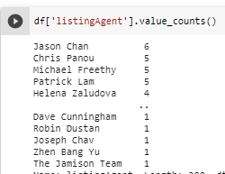
Top 5 and Low 5 Listing Agents?
The Top 5 and least 5 listing Agents are mentioned in the left image. How ever if we want to see the
Top agent based on number of houses he listed then it is shown in the right image

Slide 9
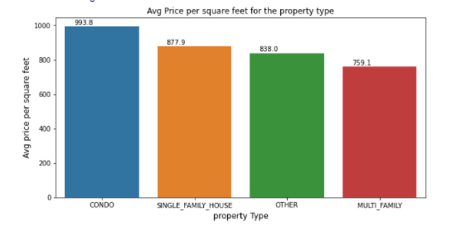
Average price/Sq.ft., for the property type?
The Average price per square feet is high for the condo Apartments and Average price per square feet is low in Multi-Family Property type

Slide 10
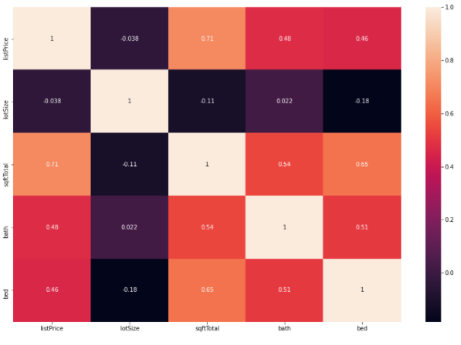
Which has highest correlation with the predictor. (Or) which has highest important feature
The Highest correlation for List price exists in Sq.ft Total with 0.71 and followed with bath 0.48 and bed 0.46. So we can consider these as important features for regression

Slide 11
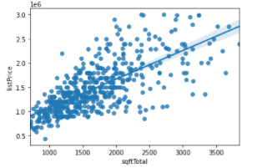
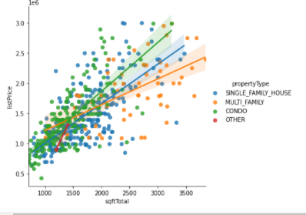
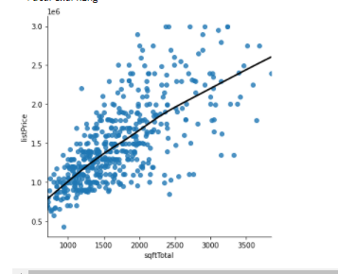
Regression Model

Slide 12
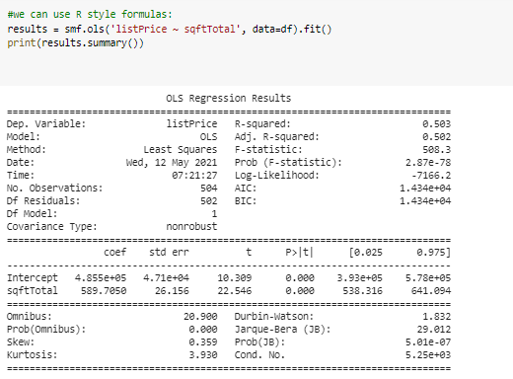
Regression model with one feature
Listprice = (4.855e+05) + 589.7050 * number of sq.ft. The coefficient of sqft is 589.70
Which means per each sq ft increment there is an increase of 589$ approx. along with intercept

Slide 13
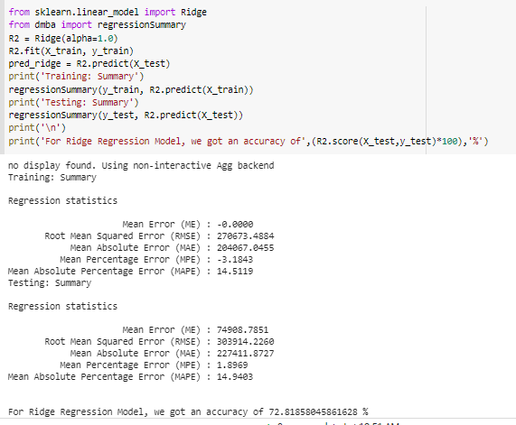
Regression with All Features using Ridge

